Slide 1
ANSI SQL
Sub-queries

Slide 2
Overview
This session will give an overview of Sub-queries in SQL.
2

Slide 3
Enabling Objectives
At the end of this session, in the next 95 minutes you will be able to:
  Demonstrate the use of Sub-queries with IN, NOT IN, ALL, ANY, SOME, EXISTS, and NOT EXISTS using Examples.
3

Slide 4
Types of Sub-Queries
  Scalar
  Single Row
  Multiple Row
IN, NOT IN, ALL, ANY, and SOME
Correlated Sub-query
EXISTS and NOT EXISTS

Slide 5
Scenario
For the complete understanding of ANSI SQL, we are going to make use of Product Management System (PMS) for ABC Traders.
ABC Traders is a company which buys collectable model cars, trains, trucks, buses, and ships directly from manufacturers and sell them to distributors across the globe. In order to manage the stocking, supply, and payment transactions, the above mentioned software is developed.
As per the requirement of the trading company, an inventory system is developed to collect the information of the products, customers, and their payment processing.

Slide 6
Database Tables
There are many entities involved in Product Management System.
We will be dealing with PMS throughout this session.
Offices
To maintain information of offices, for example, office code, address, city, and so on.
Customer
To maintain customer details, for example, customer name, address, and so on.
Employees
To maintain employee
details, for example, ID,
name, and so on.
Products
To maintain information of products, for example, product id, name, and so on.
Payments
To maintain information of payments done, for example, payment date, amount, and so on.
Orders
To maintain Orders done by customers, for example, order no, date, and so on.
Order Details
To maintain Orders done by customers, for example, order no, date, and so on.

Slide 7
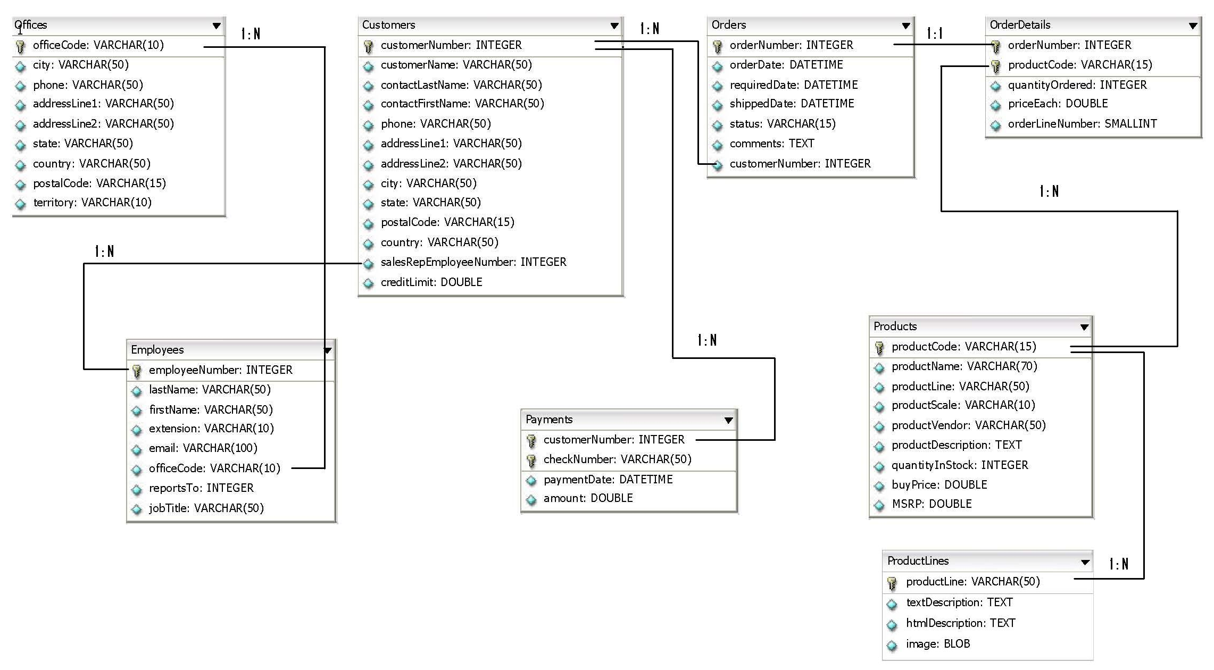
Schema Diagram

Slide 8
Types of Sub-Queries

Slide 9
Scalar Sub-query
  Returns a variable like a number, date, or string.
  Returns only one column for a single row.
  Is also known as an SQL expression.
  You can use a scalar Sub-query in:
          the WHERE clause of a SELECT
          the VALUES clause of an INSERT statement
          the SET or WHERE clauses of an UPDATE
          the WHERE clause of a DELETE statement

Slide 10
Scalar Sub-query
    Example
    display customer Number, check Number, amount for those customers whose have paid amount more than the average amount paid by the customers.
  SELECT customerNumber, checkNumber, amount
  FROM payments
  WHERE amount > (SELECT AVG(amount) FROM payments);

Slide 11
Single Row Sub-query
  A single row Sub-query returns all columns for a single row.
  You can use a single row Sub-query in:
    the INSERT statement when it provides all required values for a single row insertion
    the SET or WHERE clauses of an UPDATE
    the WHERE clause of a DELETE statement

Slide 12
Single Row Sub-query
  Legal operators for row Sub-query comparisons are:
Example
Display the Order Number and required date for all orders
whose requirement date is less than the payment date for check number 'HQ336336’.
    SELECT o.OrderNumber, o.requireddate
    FROM orders o
    WHERE o.requireddate < (SELECT p.paymentdate
    FROM payments p
    WHERE p.checknumber = 'HQ336336');
  > < >= <> != <=>
12

Slide 13
Multiple Row Sub-query
  Returns an aggregate table, which is a filtered result set of one or more columns and one or more rows.
    You can use a multiple row Sub-query
      in SELECT, INSERT, UPDATE, or DELETE statements.
    Can replace the VALUES clause in an INSERT statement, like the single-row Sub-query.

Slide 14
Multiple Row Sub-query
    Can be used in the WHERE clause of a
      SELECT, UPDATE, and DELETE statement.
      Cannot work with the equality, =, operator.
    Require either the
      IN operator, or and equality/inequality operator,
      combined with an ALL, ANY, or SOME, IN, NOT IN operator.
Notes:
You typically use a multiple row Sub-query when you lookup a related set of information that has more than one row.
Note: All columns must return the same number of rows of data.

Slide 15
Multiple Row Sub-query
Example
Multiple row Sub-query which use IN.
Display the order number and customer number from orders for all customers who have made a payment of more than 15000.
    SELECT o.OrderNumber, o.customerNumber
    FROM orders o
    WHERE o.customerNumber IN
    (SELECT p.customerNumber
    FROM payments p
    WHERE p.amount >15000);

Slide 16
IN, NOT IN, ALL, ANY, and SOME

Slide 17
IN, NOT IN, ALL, ANY, and SOME
IN:
ANSI Syntax: expression IN (Sub-query)
  An IN Sub-query condition is TRUE if the value of the expression matches one or more of the values from the Sub-query.
NOT IN:
ANSI Syntax: expression NOT IN (Sub-query)
  An NOT IN Sub-query condition is TRUE if the value of the expression matches none of the values from the Sub-query.
Notes:
Rules:
The keyword IN is equivalent to the =ANY specification.
The keywords NOT IN are equivalent to the !=ALL specification.
Because the IN Sub-query tests for the presence of rows, duplicate
rows in the Sub-query results do not affect the results of the main query.
Therefore, the UNIQUE or DISTINCT keyword in the Sub-query has no
effect on the query results, although not testing duplicates can
improve query performance.

Slide 18
IN, NOT IN, ALL, ANY, and SOME
ALL:
ANSI Syntax:
expression/operand comparison_operator ALL (Sub-query)
  The ALL keyword specifies that the search condition is TRUE if the comparison is TRUE for every value that the Sub-query returns.
  If the Sub-query returns no value, the condition is TRUE.
Notes:
Rule:
NOT IN is an alias for <> ALL. Thus, these two statements are the same

Slide 19
IN, NOT IN, ALL, ANY, and SOME
ANY/SOME:
ANSI Syntax:
  expression/operand comparison_operator ANY (Sub-query)
  expression/operand comparison_operator SOME (Sub-query)
  The SOME keyword is a synonym for ANY.
  The ANY keyword denotes that the search condition is TRUE if the comparison is TRUE for at least one of the values that is returned.
  If the Sub-query returns no value, the search condition is FALSE.
Notes:
Rule:
NOT IN is an alias for <> ALL. Thus, these two statements are the same

Slide 20
Correlated Sub-Query

Slide 21
Correlated Sub-query
Refers to a column of a table that is not in its FROM clause.
The column can be in the Projection clause or in the WHERE clause.
To find the table to which the queries refer, search the uncorrelated column until a correlation can be found.
ANSI Syntax:
    SELECT <columnName> [..,<columnName>]
    FROM <table1>
    WHERE <columnName> {=|<|>|<=|>=|<>}
    (SELECT {MIN|MAX|AVG} { <columnName>}
    FROM <table>
    WHERE<table1>.<columnName>=<table>.<columnName>
    […AND <table1>.<columnName>=<table>.<columnName>]
    );
Notes:
In general, correlated Sub-queries will diminish performance.
Use the table name or alias in the Sub-query so that there is no doubt as to which table the column is in.

Slide 22
Correlated Sub-query
It must be executed repeatedly, once for every value that the outer SELECT produces.
Example
    SELECT c1.customernumber, c1.customername
    FROM customers AS c1
    WHERE creditLimit > (SELECT AVG(creditLimit)
    FROM customers AS c2
    WHERE c2.city=c1.city);

Slide 23
Correlated vs. Non-correlated Sub-query
Difference
Correlated Sub-query | Non-Correlated Sub-query
Inner Query depends on outer query | Inner query does not depend on outer query
Outer query is executed before inner query | Inner query executes before outer query
Example: using EXISTS and NOT EXISTS keywords | Using IN and NOT IN keywords

Slide 24
EXISTS and NON EXISTS

Slide 25
EXISTS and NOT EXISTS
      ANSI Syntax:
        {where | having} [NOT] EXISTS (Sub-query)
      EXISTS and NOT EXISTS are SQL conditions/functions
      Executes a Sub-query and return either TRUE or FALSE depending on whether if rows were found or not.
      EXISTS can only be used in the WHERE clause of a query.
      The Sub-query can refer to columns in the parent query (called a correlated Sub-query).
Notes:
EXISTS will not scan all rows in the Sub-query, only one row is required to determine whether the outcome is TRUE or FALSE.
NOT EXISTS must scan all rows, which may cause performance problems.
The Sub-query does not actually produce any data, but returns a value of TRUE or FALSE.
The Sub-query always contains a reference to a column of the table in the main query.
If you use an aggregate function in an EXISTS Sub-query that includes no HAVING clause, at least one row is always returned.

Slide 26
EXISTS and NOT EXISTS
Below are examples which use EXISTS and NOT EXISTS with Sub-query.
SELECT customernumber
FROM customers AS a
WHERE EXISTS
(
SELECT * FROM orders AS b
WHERE a.customernumber =
b.customernumber
AND status ='Shipped'
);
SELECT customernumber
FROM customers AS a
WHERE NOT EXISTS
(
SELECT * FROM orders AS b
WHERE a.customernumber = b.customernumber
AND status <> 'Shipped'
);
Notes:
The first query uses EXISTS keyword in WHERE clause to return a list of customer numbers whose order status is ‘Shipped’.
Note that the outer query only returns a row where the Sub-query returns TRUE.
The second query uses NOT EXISTS keyword in WHERE clause to return a list of customer numbers whose order status is a value other than ‘Shipped’.

Slide 27
Check Your Understanding
Name types of Sub-queries.
What are Correlated Sub-queries?

Slide 28
Lend a Hand
Refer RIO_07_ANSI_SQL_SubQueries - Lend a Hand.ppt document file

Slide 29
Recap
The key points covered in this chapter are:
  The different types of Sub-queries are scalar Sub-query, single row
  Sub-query, and multiple row Sub-query.
  EXISTS and NOT EXISTS are SQL conditions that executes a Sub-query and return either TRUE or FALSE depending on whether if rows were found or not.

Slide 30

Source
Website:
  http://en.wikipedia.org/wiki/SQL#Subqueries
Disclaimer: Parts of the content of this course is based on the materials available from the Web sites and books listed above. The materials that can be accessed from linked sites are not maintained by Cognizant Academy and we are not responsible for the contents thereof. All trademarks, service marks, and trade names in this course are the marks of the respective owner(s).

Slide 31
  You have successfully completed -
  ANSI SQL Joins and Their Types
31

